Slide 1
Histology
Male genital System

Slide 2
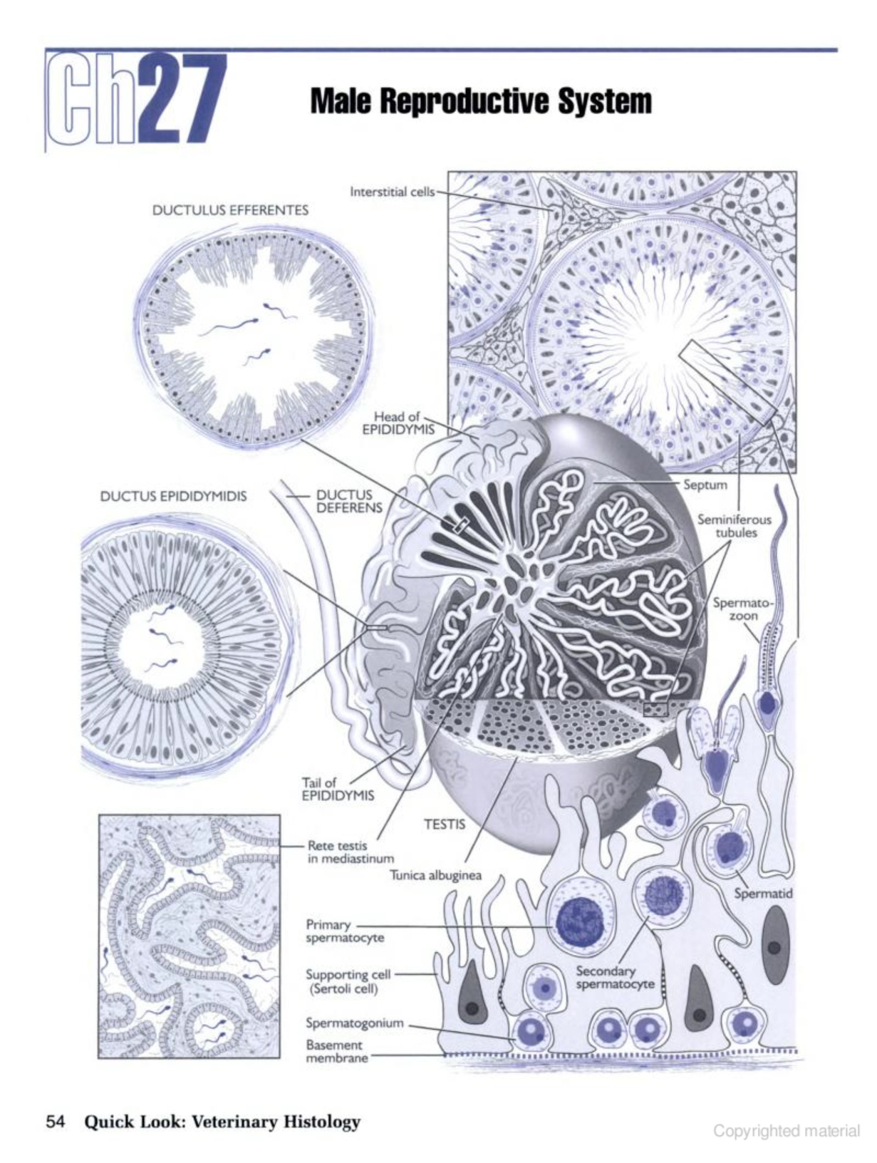

Slide 3
male reproductive system
The primary function of the male reproductive system is reproduction, which includes the production of spermatozoa, the transportation of spermatozoa from the testes out of the male body, the secretion by glands, and the placement of spermatozoa in the female reproductive tract. Spermatozoa are produced in the testes then transported from the testes by a series of ducts which become gradually larger and connect with the urethra of the penis. Various accessory glands in the male system secrete materials which together with the spermatozoa constitutes the semen.
A secondary function of the male reproductive system is the production of the male hormones which are responsible for the secondary sex characteristics of the male animal.

Slide 4
The male reproductive system is composed of several distinct organs. These include the testes, epididymis, ductus deferens, accessory glands, and the penis. The testis (plural, testes) is both an exocrine organ (compound, coiled, tubular gland) producing cells, i.e., spermatozoa, and an endocrine organ, secreting hormones, i.e., testosterone.
Accessory glands (not all are present in all species) include the ampullary glands, vesicular glands, prostate gland, bulbourethral gland and urethral glands.

Slide 5
Testes
The testes are paired organs, and each one is enclosed in a fibrous white capsule of dense connective tissue (tunica albuginea) containing blood vessels (the stratum vascular). A layer of peritoneum is tightly adhered to the tunica albuginea of each testis. The stallion has obvious smooth muscle fibers in the capsule. The connective tissue of the capsule continues into the testis on the posterior aspect as the mediastinum testis.
The dense connective tissue of the tunica albuginea is continuous with the loose areolar connective tissue of the septuli testis (septa) which extend through the parenchyma of the testis and divide it into lobules. Each lobule is composed of several seminiferous tubules (tubuli contorti) and the surrounding connective tissue. Spermatogenesis (formation of spermatozoa) occurs in the epithelial lining of the seminiferous tubules
.

Slide 6
Testis
The interstitium is composed of loose connective tissue containing fibroblasts and Leydig cells (interstitial cells). Spermatozoa produced in the seminiferous epithelium move through the lumen of the tubules to the tubuli recti (straight tubes) which extend to a network of spaces in the mediastinum, the rete testis (except in the stallion). Efferent ductules carry the spermatozoa from the rete testis, then converge to form the ductus epididymis, a convoluted duct. The ductus epididymis straightens and becomes the ductus deferens. In domestic mammals, testes are not in a major body cavity, but are enclosed in the scrotum. Each testis is suspended at the end of a tissue called the spermatic cord which contains the ductus deferens, the blood vessels, and the nerves supplying the testis.
Testis. Each testis is composed of an exocrine part (seminiferous tubules) and an endocrine part (interstitial or Leydig cells).

Slide 7
The testis is divided into lobules by septa consisting of loose areolar connective tissue. Several seminiferous tubules are found in each lobule, and interstitial cells are found in the connective tissue septa surrounding the seminiferous tubules. The seminiferous tubules are the exocrine portion of the testis producing and "excreting" spermatozoa. These tubules are lined by a stratified epithelium that consists of the developing germ cells and supporting cells (Sertoli cells).

Slide 8
Seminiferous tubules. The stratified epithelium of the seminiferous tubules is composed of different stages of developing germ cells.
Spermatogonia are stem cells located near the basement membrane of the tubule which proliferate by mitosis. Some of the progeny cells differentiate into sperm and move away from the basement membrane toward the lumen of the tubule. These differentiating cells first undergo meiosis then undergo a morphological change to become spermatozoa. Some of the progeny cells undergo mitosis again to produce more progeny cells providing a continuous source of stem cells for the production of spermatozoa.

Slide 9
Interstitium: The interstitial tissue of the testis consists of loose areolar connective tissue containing numerous reticular fibers which serves to support the seminiferous tubules. The interstitial cells (Leydig cells), located in this connective tissue, are responsible for the synthesis and secretion of the steroid hormone testosterone.

Slide 10
Spermatogenesis: the process by which stem cells develop into mature spermatozoa. There are three phases: (1) Spermatocytogenesis (Mitosis), (2) Meiosis, and (3) Spermiogenesis.
Spermatocytogenesis (also called Mitosis):
Stem cells (Type A spermatogonia; singular = spermatogonium) divide mitotically to replace themselves and to produce cells that begin differentiation (Type B spermatogonia). Spermatogonia have spherical or oval nuclei, and rest on the basement membrane.

Slide 11
2. Meiosis: Cells in prophase of the first meiotic division are primary spermatocytes. They are characterized by highly condensed chromosomes giving the nucleus a coarse chromatin pattern and an intermediate position in the seminiferous epithelium. This is a long stage, so many primary spermatocytes can be seen. Primary spermatocytes go through the first meiotic division and become secondary spermatocytes. The cells quickly proceed through this stage and complete the second meiotic division. Because this stage is short there are few secondary spermatocytes to be seen in sections. Meiosis is the process by which the diploid number of chromosomes present in spermatogonia (the stem cells) is reduced to the haploid number present in mature spermatozoa.

Slide 12
The products of the second meiotic division are called spermatids. They are spherical cells with interphase nuclei, positioned high in the epithelium. Since spermatids go through a metamorphosis into spermatozoa, they occur in early through late stages. All of these progeny cells remain attached to each other by cytoplasmic bridges. The bridges remain until sperm are fully differentiated.

Slide 13
Spermiogenesis:
This is the metamorphosis of spherical spermatids into elongated spermatozoa. No further mitosis or meiosis occurs. During spermiogenesis, the acrosome forms, the flagellar apparatus forms, and most excess cytoplasm (the residual body) is separated and left in the Sertoli cell. Spermatozoa are released into the lumen of the seminiferous tubule. A small amount of excess cytoplasm (the cytoplasmic droplet) is shed later in the epididymis.

Slide 14
Sertoli cell and developing sperm cells
: An interaction at all stages of differentiation, the spermatogenic cells are enclose contact with Sertoli cells which are thought to provide structural and metabolic support to the developing sperm cells. A single Sertoli cell extends from the basement membrane to the lumen of the seminiferous tubule although its cytoplasm is difficult to distinguish at the light microscopic level. They are characterized by the presence of a vesicular, oval, basally positioned nucleus which contains a prominent nucleolus. The nuclear envelope often contains a definite fold. Sertoli cells are endocrine cells - they secrete the polypeptide hormone, inhibin. Inhibin acts at the level of the pituitary to reduce the secretion of follicle stimulating hormone (FSH).

Slide 15
Blood-testis barrier.
Large molecules cannot pass from the blood into the lumen of a seminiferous tubule due to the presence of tight junctions between adjacent Sertoli cells. The spermatogonia are in the basal compartment and the more mature forms such as primary and secondary spermatocytes and spermatids are in the luminal compartment. The function of the blood-testis barrier may be to prevent an auto-immune reaction with sperm; therefore, a male animal is capable of making antibodies against his own sperm. Injection of sperm antigens causes inflammation of the testis and reduced fertility. Thus, the blood-testis barrier may reduce the ability of sperm proteins to induce an immune response.

Slide 16
The Duct System
After production in the testes, spermatozoa pass through a series of ducts in their journey out of the male system.
Tubuli recti, Rete Testis, Efferent ductules
The genital ducts are tubular organs in which the lamina epithelialis varies from the stratified epithelium in the testes to a transitional epithelium in the urethra. In the terminal part of the seminiferous tubules, the epithelium contains only Sertoli cells which gradually blends with the squamous, cuboidal or columnar epithelium (species variation) of the tubuli recti and the rete testis. These epithelial cells may actually represent a continuation of the Sertoli cells which line the seminiferous tubules.

Slide 17
Epididymis
The ductus epididymis is lined with a pseudostratified stereociliated columnar epithelium. Stereocilia are actually nonmotile, long microvilli which serve to increase the absorptive and/or secretory surface of this epithelium. Which is associated with the connective tissue and muscle, the ductus epididymis coils to form the head, body and tail of the epididymis which then continues into the ductus deferens. Spermatozoa are stored within the epididymis while they undergo maturation to become mature sperm.

Slide 18
Ductus Deferens
The ductus epididymis continues as the ductus deferens which is also lined by a pseudostratified columnar epithelium. However, the lamina propria and submucosa of the ductus deferens is areolar loose connective tissue, and the tunica muscularis is very thick and contains two layers of smooth muscle. The tunica serosa is present and typical.

Slide 19
Urethra
The male urethra consists of two portions; the pelvic urethra and the penile urethra. Both portions are lined with transitional epithelium, both contain erectile tissue, and both contain branched tubular mucous glands, the urethral glands.

Slide 20
Accessory Glands
Ampullary, vesicular, prostate, bulbourethral, and urethral glands
The products of these glands serve to nourish and activate the spermatozoa, to clear the urethral tract prior to ejaculation, serve as the vehicle of transport of the spermatozoa in the female tract, and to plug the female tract after placement of spermatozoa to help ensure fertilization. Although the glands are usually described as being branched tubular or branched tubuloalveolar, they vary in their organization and in their distribution in different species.

Slide 21
Accessory sex glands
Ampullary Glands: This branched tubular gland lined by simple columnar epithelium is an enlargement of the ductus deferens in its terminal portion. This is a typical tubular gland in ruminants, horses and dogs; absent in the cat and poorly developed in boars. The function of the white serous secretion is not known.
Vesicular Glands: The secretary end pieces of this gland are lined with simple columnar epithelium; the main ducts are lined with stratified columnar epithelium. These glands do not occur in carnivores, but are present in some form in horses, ruminants and swine. Seminal fluid and the product of this gland, serves as a vehicle for the transport of spermatozoa.

Slide 22
Prostate gland:
Grossly the prostate gland can be divided into two parts: the body and the disseminate part. Low cuboidal to low columnar epithelium provides the lining for this compound, tubuloalveolar gland which consists primarily of serous secretory end pieces. The secretion of this gland is more serous in dogs and more mucous in bulls. It serves to promote the movement of spermatozoa and to form a vaginal plug. Additionally, in bulls, the secretion contains high amounts of fructose and citric acid. Concretions may be present in the secretory end pieces as well as parts of the duct system.

Slide 23
Bulbourethral Glands
The lining of these paired, compound, tubuloalveloar glands is simple columnar epithelium. A capsule of dense connective tissue contains some smooth muscle as well as skeletal muscle of the bulbocavernous and urethral muscles. All domestic species have these glands except the dog, and their mucous secretion serves to clear the urethra of urine and to lubricate it and the vagina. The product may also serve as an energy source for the spermatozoa.
Urethral Glands
In some species, branched tubular mucous glands are found along the length of the urethra, especially dorsal to the lumen of the urethra. The exact function of their product is not clear.

Slide 24
Penis: the copulatory organ
The penis provides an outlet for both urine and the copulatory ejaculate (spermatozoa and semen). The histology and gross anatomy of the penis varies dramatically from species to species and from region to region within the same species. In general, the body of the penis consists of the urethra, erectile tissue (corpora cavernosa penis and corpora cavernosum urethra), smooth and skeletal muscle, touch and pressure receptors (Pacinian corpuscles) and a dense connective tissue capsule (tunica albuginea).

